Slide 1

Implementation and Evaluation of Proportional Schedulers
team 1
21 이태우
21 임주환
Notes:
버츄얼박스와 우분투를 설치 데모영상입니다.

Slide 2
Overall Contents
1. Stride Scheduler
Introduction
Implementation
Analysis
Conclusion
2. Lottery Scheduler
Introduction
Implementation
Analysis
Conclusion

Slide 3
1. Stride Scheduler Contents
1. Implementation of Stride Scheduler.
Review stride scheduler
Interface
Implementation Specifics
2. Analysis Fairness Metrics
Why we need to use window
Analysis Fairness (Various Ratio, Periodicity)
3. Conclusion
Fairness
Periodicity

Slide 4
Stride Scheduler Review
process | tickets | stride
A | 50 | 20
B | 100 | 10
C | 250 | 4
pass
0
5
7
6
1
4
3
* Let, (stride) = 1000/(tickets)
2
A
B
C
A
B
C
C
C
B
C
C
0
1
2
3
4
5
6
7
8
Unit Times
A : B : C = 1 : 2 : 5

Slide 5
Stride Scheduler Interface (1/4)
Three Major Interfaces
register ()
scheduling ()
unregister ()
Modify scheduler’s logic and data structure with minimal changes
stride_scheduler.c
register ()
sched_contexts_list
unregister ()
scheduling ()
return by ref.
ready queue
start
running
exit
wait queue

Slide 6
Stride Scheduler Interface (2/4)
register (thread)
Apply given thread to the scheduler so that the scheduler can select it.
When you must call register ()
thread creation
thread unblocking
stride_scheduler.c
register ()
sched_contexts_list
unregister ()
scheduling ()
return by ref.
ready queue
start
running
exit
wait queue

Slide 7
Stride Scheduler Interface (3/4)
scheduling ()
Select a next thread to run according to the scheduler’s rule
When you must call scheduling ()
thread scheduling
stride_scheduler.c
register ()
sched_contexts_list
unregister ()
scheduling ()
return by ref.
ready queue
start
running
exit
wait queue

Slide 8
Stride Scheduler Interface (4/4)
unregister (thread)
Detach given thread from the scheduler so that the thread will not be scheduled anymore.
When you must call unregister ()
thread blocking
thread exit
stride_scheduler.c
register ()
sched_contexts_list
unregister ()
scheduling ()
return by ref.
ready queue
start
running
exit
wait queue

Slide 9
Stride Scheduler Implementation (1/2)
Data Structure: Sorted Linked Lists
Follow basic data structure for the thread management (linked list)
Simple and Straightforward.
Bad time complexity, but the number of threads in Pintos is small.
<stack>
<stack>
<stack>
<tcb>
<tcb>
<tcb>
<sched_context>
pass = 10
tickets = 3
<sched_context>
pass = 20
tickets = 3
<sched_context>
pass = 30
tickets = 3
head
tail
Ascending Order of ‘pass’ Field
Easily get next thread to run
(we need a thread with minimum ‘pass’ field)

Slide 10

Stride Scheduler Implementation (2/2)
If a thread registers with the scheduler later,
Set the ‘pass’ field of newly applied thread as the minimum of ‘pass’ fields of threads in the stride scheduler’s sorted linked list.
Avoid monopolization!
e.g.
competiton occurs
= no monopolization
monopolize cpu until
the pass value of new thread
reaches to
pass
pass
set the pass value
of new thread as
new thread
new thread

Slide 11
Fairness Evaluation Plan (1/2)
The final ratio of cumulative runtime may not accurately represent fairness.
e.g. Two schedulers X and Y for threads A and B with equal weights. Which is fairer?
A
scheduler
X
A
A
A
A
A
B
B
B
B
B
B
t
total runtime
thread
runtime
5t
A
scheduler
Y
B
B
A
B
A
B
A
B
B
A
B
t
total runtime
thread
runtime
4t
6t

Slide 12
Fairness Evaluation Plan (2/2)
It is more reasonable to introduce windows (i.e. fixed size time intervals) and summate runtime separately.
thread
runtime
A
time interval [2t, 6t]
B
scheduler
X
A
A
A
A
A
B
B
B
B
B
t
total runtime
0
t
2t
3t
window offset
thread
runtime
A
B
scheduler
Y
B
B
A
B
A
B
A
B
B
A
t
total runtime
0
t
2t
3t
window offset
slide window

Slide 13
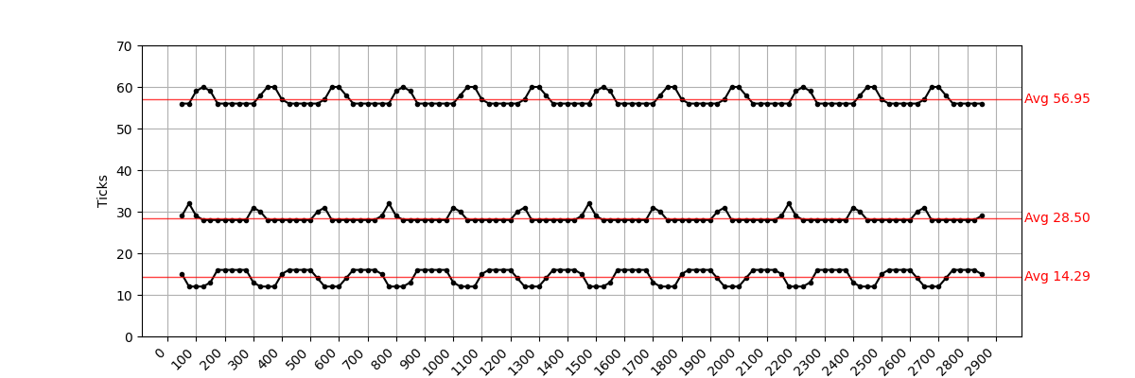
Stride Scheduler Fairness Evaluation (1/6)
C
B
A
window start (ticks)
<Parameters>
The graph above shows the execution time of three threads A, B and C with a ticket ratio of 1 : 2 : 4 respectively.
parameter | value
Test Period | 3000 ticks
Window Size | 100 ticks
Stride of Window | 25 ticks / step
K | 27000
A.tickets | 1
B.tickets | 2
C.tickets | 4
The average ticks in a window per threads
A : B : C ≈ 14.29 : 28.50 : 56.95
≈ 1.00 : 1.99 : 3.99
※ 1 tick ≈ 10ms, X.stride = K / X.tickets

Slide 14
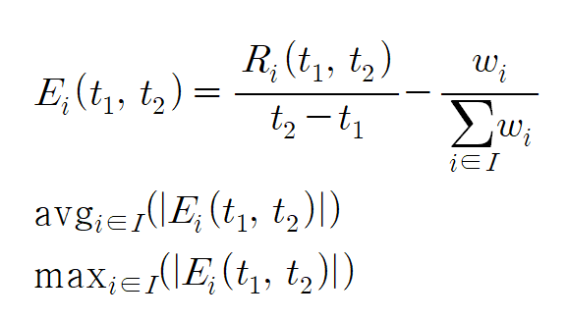
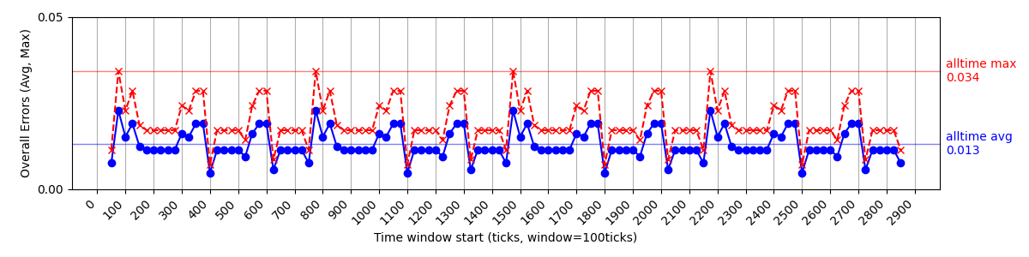
Stride Scheduler Fairness Evaluation (2/6)
Calculate the error between expected and actual CPU usage
The following chart shows the average and maximum error of threads in a window.
Alltime Error Average was 0.013
Alltime Largest Error was 0.034

Slide 15
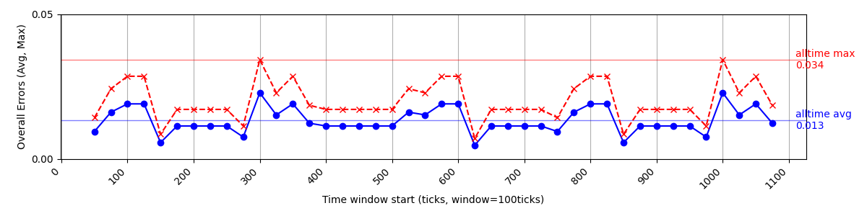
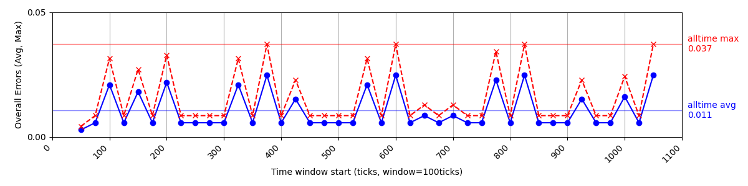
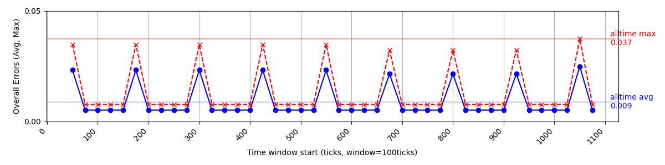
Stride Scheduler Fairness Evaluation (3/6)
All test case shows good fairness.
(case 1) 1 : 2 : 4
alltime avg error = 0.013
alltime max error = 0.034
(case 2) 1 : 4 : 9
alltime avg error = 0.011
alltime max error = 0.037
(case 3) 1 : 10 : 20
alltime avg error = 0.009
alltime max error = 0.037

Slide 16
Stride Scheduler Fairness Evaluation (4/6)
We can observe a wave-like pattern in the error metrics.
700ticks
700ticks
700ticks
700ticks

Slide 17

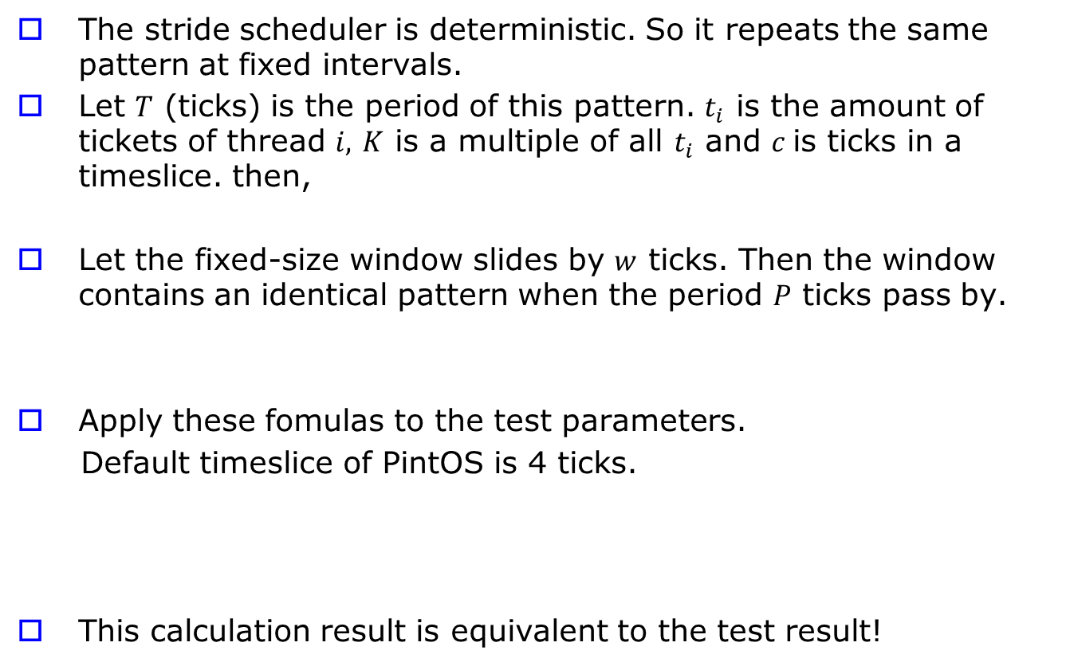
Stride Scheduler Fairness Evaluation (5/6)
The stride scheduler is deterministic. So it repeats the same pattern at fixed intervals.
Let $T$ (ticks) is the period of this pattern. $t_{i}$ is the amount of tickets of thread $i,$ $K$ is a multiple of all $t_{i}$ and $c$is ticks in a timeslice. then,
Let the fixed-size window slides by $w$ ticks. Then the window contains an identical pattern when the period $P$ ticks pass by.
Apply these fomulas to the test parameters.
Default timeslice of PintOS is 4 ticks.
This calculation result is equivalent to the test result!
parameter | value
Stride of Window | 25 ticks / step
K | 27000
A.tickets | 1
B.tickets | 2
C.tickets | 4
T = 4 * 27000 * (1+2+4)/27000 = 28
P = LCM (28, 25) = 700 (ticks)

Slide 18
Stride Scheduler Fairness Evaluation (6/6)
Insight : There are good days and bad days within a single cycle. And this cycle is deterministic.
Worst
Best
pass
pass
pass
 | A | B | C
expected | 1 | 2 | 4
actual | 1 | 0 | 0
 | A | B | C
 | 1 | 2 | 4
 | 1 | 1 | 2
A | B | C
1 | 2 | 4
1 | 2 | 4

Slide 19
Conclusion (1/2)
The Period of the stride scheduler is important when you evaluate fairness.
For example, if the window size is equal to the stride scheduler’s period, you get a constant error metrics. But this does not mean that the stride scheduler has exactly constant error in all aspects. You have to set the window size either smaller or greater than scheduler’s period. 50% or 150% of the period looks better.
The Period of the stride scheduler is deterministric. So you do not need long term test!
One period of stride scheduler has entire pattern of itself. It is useful to evaluate its performance.
Mathmatical alaysis is vaild because the pattern in a period is deterministic.

Slide 20
Conclusion (2/2)
Stride Scheduler shows very good fairness (Especially compared to the lottery scheduler, and in a small interval of time)
Characteristic of Lottery scheduler will be presented later...

Slide 21
2. Lottery Scheduler Content
1. What is Lottery Scheduling
Introduction to the basic concepts and characteristics of the algorithm
2. Implementation
Explanation of the Core logic, focusing on the next_thread_to_run() function.
3. Experimental Result & Analysis
Case 1 : Fair Distribution(1:1:1 Ratio)
Case 2 : Unfair Distribution(20:1:1 Ratio)
4. Conclusion
Summery of the pros and cons of Lottery Scheduling, as validated by the experiments.

Slide 22
What is Lottery Scheduling?
Definition : Proportional-share Scheduler
It is a type of fair-share scheduler that aims to guarantee each job a certain percentage of CPU time.
Core Concept : Tickets
It uses “tickets” to represent a process’s share of a resource.
A process’s percentage of the total tickets represents its expected percentage of the CPU time.
(e.g., If Process A has 75 tickets and B has 25, A is expected to receive 75% of the CPU and B 25%)
Mechanism: The Lottery
The scheduler probabilistically determines the next process to run by holding a “lottery”
Processes with more tickets are given a high probability of being selected to run.

Slide 23
Lottery Scheduler Implementation(1/3)
Store a random number in the winner variable.
Iterate through the ready_list, modifying the winner variable.
Subtract the ticket value of the current thread from the winner variable
The thread that causes winner to become less than 0 is selected
winner = getrandom(0,tooal_tickets)
node_t *current = head;
While(currnet){
winner -= current->tickets;
If(winner < 0)
total_tickets -= current->tickets;
return current;
current = current->next;
}
winner : 300
Thread A
Tix : 100
Thread B
Tix : 50
Thread C
Tix : 200
winner : 200
total_tickets:350

Slide 24
Lottery Scheduler Implementation(2/3)
Store a random number in the winner variable.
Iterate through the ready_list, modifying the winner variable.
Subtract the ticket value of the current thread from the winner variable
The thread that causes winner to become less than 0 is selected
winner = getrandom(0,tooal_tickets)
node_t *current = head;
While(currnet){
winner -= current->tickets;
If(winner < 0)
total_tickets -= current->tickets;
return current;
current = current->next;
}
winner : 200
Thread A
Tix : 100
Thread B
Tix : 50
Thread C
Tix : 200
winner : 150
total_tickets:350

Slide 25
Lottery Scheduler Implementation(3/3)
Store a random number in the winner variable.
Iterate through the ready_list, modifying the winner variable.
Subtract the ticket value of the current thread from the winner variable
The thread that causes winner to become less than 0 is selected
winner = getrandom(0,tooal_tickets)
node_t *current = head;
While(currnet){
winner -= current->tickets;
If(winner < 0)
total_tickets -= current->tickets;
return current;
current = current->next;
}
Winner!
winner : 150
Thread A
Tix : 100
Thread B
Tix : 50
Thread C
Tix : 200
winner :-50
total_tickets:150

Slide 26
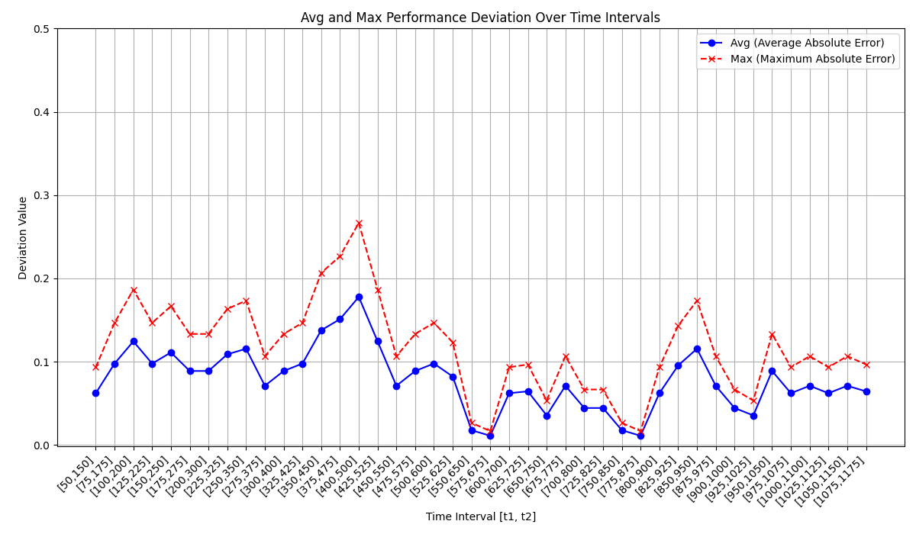
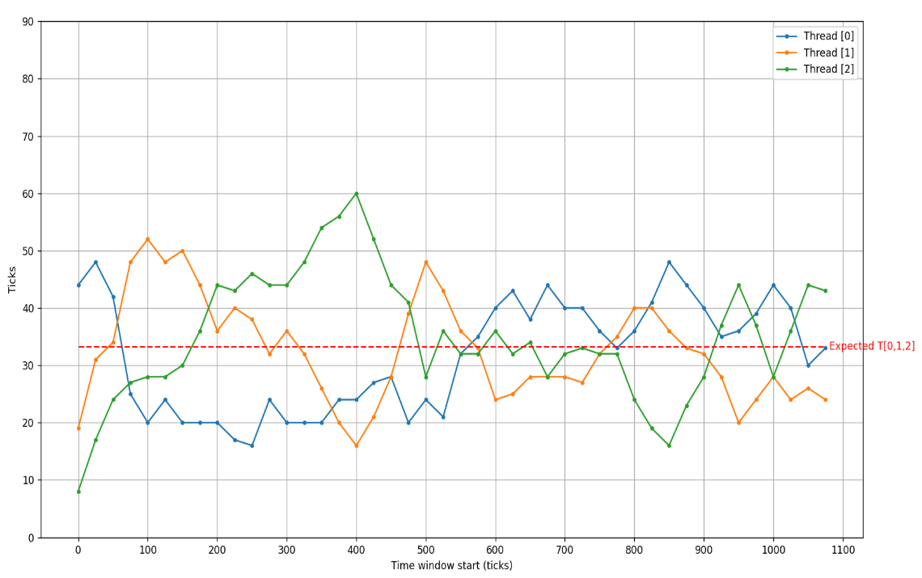
Experiment : Fair Distribution
1:1:1 Ratio Test
Analysis
The momentary share is unpredictable and fluctuates significantly.
This clearly demonstrate the probabilistic nature of the lottery scheduler.
Share per Time Window
Parameter | Value
Test Period | 1200 ticks
Window Size | 100 ticks
Stride of Window | 25 ticks / step
A.Tickets | 10
B.Tickets | 10
C.Tickets | 10

Slide 27
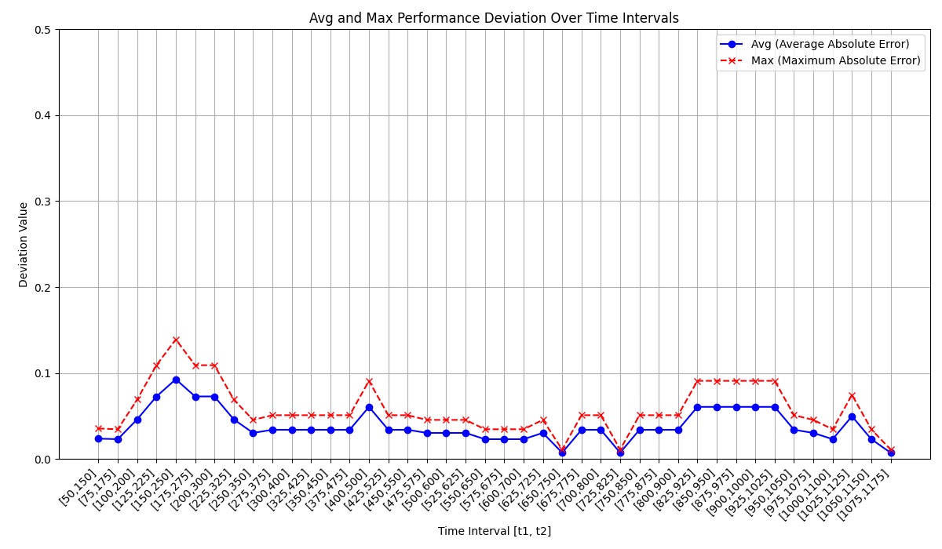
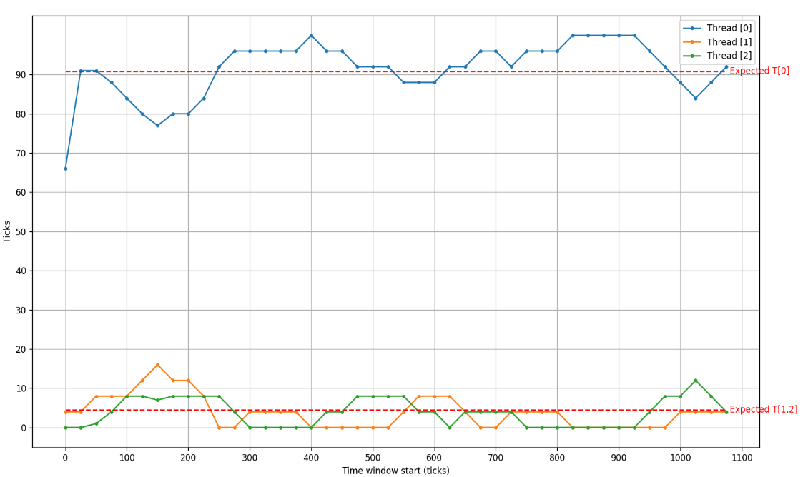
Experiment : Unfair Distribution
20:1:1 Ratio Test
Analysis
Low-ticket threads were frequently starved, receiving 0 ticks for entire 100tick windows
This demonstrates that lottery scheduling provides no guarantee of response time.
Share per Time Window
Parameter | Value
Test Period | 1200 ticks
Window Size | 100 ticks
Stride of Window | 25 ticks / step
A.Tickets | 20
B.Tickets | 1
C.Tickets | 1

Slide 28
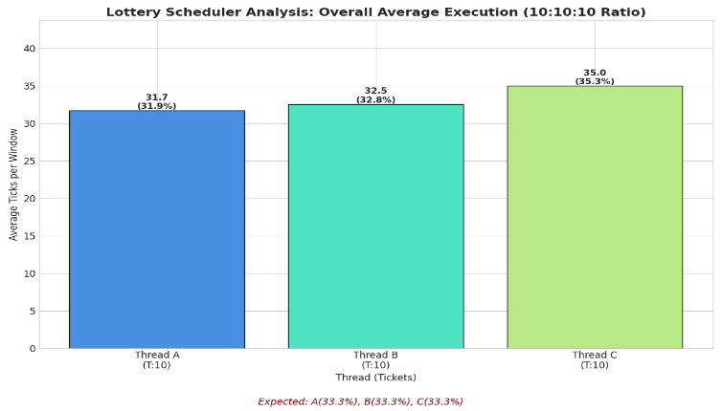
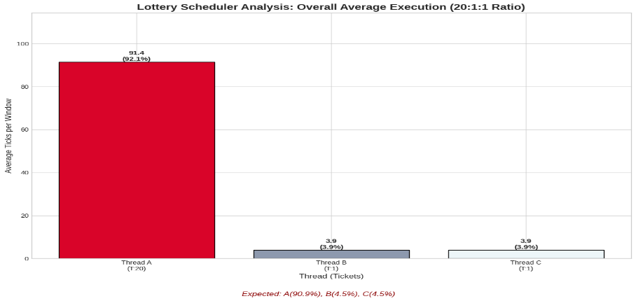
Why Lottery Scheduling
Rational for Lottery scheduling
Core Trade-off
Weakness : Inability to guarantee short-term fairness and response time for low-ticket threads due to high variance.
Advantage : Simplicity of implementation and low overhead for thread management.
Long-term Proportionality
Based on Law of Large Numbers, the probabilistic model ensures that over a long execution period, the actual CPU share for each thread converges to its expected share, proportional to its ticket count.
Experimental result for both 1:1:1 and 20:1:1 ratios confirm that despite short-term fluctuations, the overall average share approximates the expected values.

Slide 29
Conclusion
Long-term Fairness Validated
Our experiments confirm that as execution time increase, Lottery Scheduling ensures each threads receives a CPU share proportional to its ticket allocation.
The Value of Simplicity
The core of this scheduler lies in its simplicity and efficiency, implementing proportional sharing with a simple logic and without complex state-tracking.
Adding and removing threads is a very lightweight operation.
The Core Trade-off
Lottery Scheduling presents a clear trade-off : it sacrifices short-term predictability and response time guarantee for the practical benefits of implementation simplicity and long-term resource balance.
Suitable Use Cases
Therefore, it is rational choice in environments where overall resource balance and ease of implementation are more critical than strict, real-time guarantees.

Slide 30
Thank you!

